Slide 1
Planning a Software Project

Slide 2
Project Failures
Major reasons for project runaways
  unclear objectives
  bad planning
  no project management methodology
  new technology
  insufficient staff
All of these relate to project management
Effective project management is key to successfully executing a project

Slide 3
Why improve PM?
Better predictability leading to commitments that can be met
Lower cost through reduced rework, better resource mgmt, better planning,..
Improved quality through proper quality planning and control
Better control through change control, monitoring etc.

Slide 4
Why improve PM ….
Better visibility into project health and state leading to timely intervention
Better handling of risks reducing the chances of failure
All this leads to higher customer satisfaction
And self and organization improvement

Slide 5
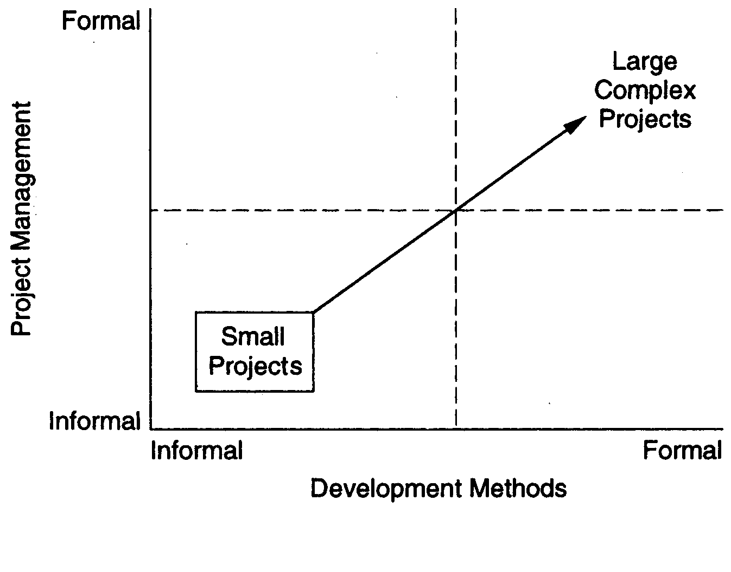
Two Dimensions in project execution

Slide 6
Process-based Project Execution
Small project both engg and PM can be done informally
Large projects require formality
Formality: well defined processes used for each task; measurements used to control
Here we focus on processes for PM only

Slide 7
The Project Mgmt Process
Has three phases - planning, monitoring and control, and closure
Planning is done before the main engineering life cycle (LC) and closure after the LC
Monitoring phase is in parallel with LC

Slide 8
Project Planning
Basic objective:
  To create a plan to meet the commitments of the project
  create a path that, if followed, will lead to a successful project
Planning involves
  defining the LC process to be followed, estimates, detailed schedule, plan for quality, etc.
Main output
  a project management plan, and
  project schedule

Slide 9
Key Planning Tasks
Define suitable processes for executing the project
Estimate effort
Define project milestones and create a schedule
Define quality objectives and a quality plan
Identify risks and make plans to mitigate them
Define measurement plan, project-tracking procedures, training plan, team organization, etc.

Slide 10
Process Planning
Plan how the project will be executed, (ie. the process to be followed)
Process will decide the tasks, their ordering, milestones
Hence process planning is an important project planning task
Should plan for LC and PM processes as well as supporting processes

Slide 11
Life Cycle Process
Various LC models - waterfall, iterative, prototyping; diff models suit different projects
During planning can select the model that is best for the project
This gives the overall process which has to be fine-tuned to suit the project needs
Usually done by process tailoring - changing the process to suit the project
Tailoring finally results in adding, deleting, modifying some process steps

Slide 12
Planning Principles
Understand scope
Involve customer in planning.
Recognize planning is iterative.
Estimate based on what you know.
Consider risk as you define plan.
Be realistic- 100 %..omissions in communication.
Adjust granularity ( detail) as you define plan.
Define how you ensure quality.
Accommodation of changes.
Track plan frequently

Slide 13
Project Planning
Objective is to make reasonable estimates of resources, cost, schedule. ( Manager).
Suggest best case & worst case scenario.

Slide 14
Main objectives with a project plan
Guide project execution
Document project planning assumption
Document project planning decisions regarding alternatives chosen
Facilitate communication among stakeholders

Slide 15
Define key management reviews as to content, extent, and timing
Provide a baseline for progress measurement and project control

Slide 16
The form of a project plan
1. Scope and Objectives –
2. Work Breakdown Structure (WBS) –
3. Budget and Schedule –
4. Risks –
5. Monitoring and Reporting Mechanisms –
6. Resources –
7. Knowledge & Skills –
8. Stakeholder Involvement -

Slide 17
Steps/ Task Set
1. Establish Project scope.
2.Determine Feasibility.
3.Analyze Risks.
4.Define required sources.
a) Determine human resources required.
b) Define reusable software resources.
c) Identify environmental resources.
5 . Identify cost & effort.
a) Decompose the problem.
b) Develop two or more estimates using size, function points, process tasks or usecases.

Slide 18
c) Reconcile Estimates.
6. Develop a project schedule.
Establish meaningful task set.
Define a task network
Use scheduling tools to develop a timeline chart.
Define schedule tracking mechanisms.

Slide 19
Different types of project plans
Quality plan - Includes the quality procedures and standards that concern the project.
Validation plan - Covers approaches, resources and schedule involved in the system validation.
Configuration management plan – Consists of the configuration management procedures and structures to support the project.
Maintenance plan - Predicts the maintenance requirements, maintenance costs and the effort required.
Staff development plan - Includes how available skills and experience will be developed

Slide 20
Project Planning
Scope Management
Project Estimation

Slide 21
Project Planning
Performed before the production of software actually starts.
set of multiple processes
Scope Management
creates boundaries of the project by clearly defining what would be done in the project and what would not be done.
During Project Scope management, it is necessary to -
Define the scope
Decide its verification and control
Divide the project into various smaller parts for ease of management.
Verify the scope
Control the scope by incorporating changes to the scope

Slide 22
Software Scope
Functions that are delivered to the end user.
Includes
Data as input & output.
Scope is defined using..
1. A narrative description of software scope is developed after communication with stake holders.
2. A set of use cases ( actions, events) is developed by end users.

Slide 23
Need for cost estimation
The software cost estimation provides:
the vital link between the general concepts and techniques of economic analysis and the particular world of software engineering.
Software cost estimation techniques also provides an essential part of the foundation for good software management.

Slide 24
Cost of a project
The factors that affect cost of a project is due to:
  the requirements for software, hardware and human resources
  the cost of software development is due to the human resources needed
  most cost estimates are measured in person-months (PM)
  the cost of the project depends on the nature and characteristics of the project, at any point, the accuracy of the estimate will depend on the amount of reliable information we have about the final product.

Slide 25
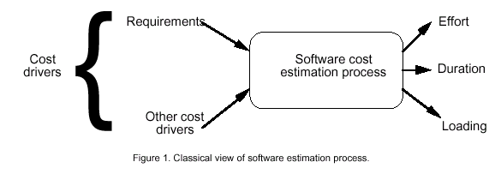
Software Cost Estimation

Slide 26
COCOMO models
The COstructive COst Model (COCOMO) is the most widely used software estimation model in the world. It
The COCOMO model predicts the effort and duration of a project based on inputs relating to the size of the resulting systems and a number of "cost drives" that affect productivity.

Slide 27
Emperical Estimation Model- COCOMO
Boehm
Software development project can be classified into one of the following three categories based on the development complexity:
1. organic-"small" teams with "good" experience working with "less than rigid" requirements, the project deals with developing a well understood application program
2. semidetached- "medium" teams with mixed experience working with a mix of rigid and less than rigid requirements,
The development consists of a mixture of experienced and inexperienced staff.
3.Embedded- developed within a set of "tight" constraints. It is also combination of organic and semi-detached projects.

Slide 28
1981
software cost estimation should be done through three stages
Basic COCOMO,
Intermediate COCOMO
Complete COCOMO.

Slide 29
Basic COCOMO Model
Effort =a1 х(KLOC)^{a 2} PM
KLOC is the estimated size of the software product expressed in Kilo Lines of Code,
•a1, a2, b1, b2
are constants for each category of software products.
Tdev = b1 x (Effort)^{b2} Months
Tdev is the estimated time to develop the software, expressed in months,
• Effort is the total effort required to develop the software product, expressed in person months (PMs).

Slide 30
Effort
Effort Equation
  Effort = a * (KLOC)^{b} (person-months)
    where Effort = number of person-month (=152 working hours),
    a = a constant,
    KLOC = thousands of “lines of code" (LOC) and
    b = a constant.

Slide 31
Effort
Effort Equation
  Effort = a * (KLOC)^{b} (person-months)
    where Effort = number of person-month (=152 working hours),
    a = a constant,
    KLOC = thousands of “lines of code" (LOC) and
    b = a constant.

Slide 32
Productivity
Productivity equation
  (KLOC) / (Effort)
    where Effort = number of person-month (=152 working hours),

Slide 33
Schedule
Schedule equation
  Duration, D = C * (E)^{d} (months)
    where D = number of months estimated for software development.

Slide 34
Average Staffing
Average Staffing Equation
  (Effort) / (D) (FSP)
    where FSP means Full-time-equivalent Software Personnel.

Slide 35
Estimation of development effort
For the three classes of software products, the formulas for estimating the effort based on the code size.
Organic : Effort = 2.4(KLOC)^{1.05} PM
Semi-detached : Effort = 3.0(KLOC)^{1.12} PM
Embedded : Effort = 3.6(KLOC)^{1.20} PM

Slide 36
Estimation of development time
For the three classes of software products, the formulas for estimating the development time based on the effort are given below:
Organic : Tdev = 2.5(Effort)^{0.38} Months
Semi-detached : Tdev = 2.5(Effort)^{0.35} Months
Embedded : Tdev = 2.5(Effort)^{0.32} Months

Slide 37
Example:
Assume that the size of an organic type software product has been estimated to be 32,000 lines of source code. Assume that the average salary of software engineers be Rs. 15,000/- per month. Determine the effort required to develop the software product and the nominal development time.
From the basic COCOMO estimation formula for organic software:
Effort = 2.4 х (32)^{1.05} = 91 PM
Nominal development time = 2.5 х (91)^{0.38} = 14 months
Cost required to develop the product = 14 х 15,000 = Rs. 210,000/-

Slide 38
Intermediate COCOMO model
The basic COCOMO model assumes that effort and development time are functions of the product size alone.
Other project parameters besides the product size affect the effort required to develop the product as well as the development time.
The effect of all relevant parameters must be taken into account.
Refines the initial estimate obtained using the basic COCOMO expressions by using a set of 15 cost drivers (multipliers)

Slide 39
The cost drivers can be classified as being attributes of the following items:
Product: The characteristics of the product that are considered include the inherent complexity of the product, reliability requirements of the product, etc.
Computer: Characteristics of the computer that are considered include the execution speed required, storage space required etc.
Personnel: The attributes of development personnel that are considered include the experience level of personnel, programming capability, analysis capability, etc.

Slide 40
Complete COCOMO model
Shortcoming of both the basic and intermediate COCOMO models is that they consider a software product as a single homogeneous entity.
Most large systems are made up several smaller sub-systems.
The cost of each subsystem is estimated separately.
1. Database part
2. Graphical User Interface (GUI) part
3. Communication part

Slide 41
single variable model
When a model uses single basic variable to calculate all others it is said to be a single variable model.
IF several variables are used to describe software development process .
Selected equations combine these variables to give estimate of cost & time.

Slide 42
Single Variable Model
Eqn is used to calculate cost, time, effort.
All depend on the size.
C= aL ^{b}
Two types of model
Static
A unique variable (say, size) is taken as a key element for calculating all others(say cost time etc)
Calculating (say, cost, time etc.)
The form of equation used is the same for all calculations.
Dynamic
All variables are interdependent and there is no basic variable as in the static model

Slide 43
Single variable model
Use an equation to estimate the desired values such as cost, time, effort etc
Depend on the same variable used as predictor(say,size) C=aL
C :cost L :size
a&b : constants derived from the historical data of the organization
a & b depend on the local development environment, these models are not transportable to different organizations
b

Slide 44
• The software Engineering Laboratory of the university of Maryland has established a model, the SEL model, for estimating its own software production
E=1.4L ^{0.93}
Effort(person-month)
DOC=30.4L ^{0.90}
Documentation(number of pages)
D=4.6L ^{0.26}
Duration(month)
L:number oflinesofcode(thousands of lines)used as predictor

Slide 45
Static Multi varible Model.
Depend on several variables.
Methods used, user participation…..
Waltson & Felix at IBM.
Relation between lines of code(L)
& Effort (E) in person months.
E= 5.2 L ^{0.91}

Slide 46
Duration of development in month.
D= 4.1 L ^{0.36}
Productivity Index = I

Slide 47
COCOMO Models
COCOMO is defined in terms of three different models:
  the Basic model,
  the Intermediate model, and
  the Detailed model.
The more complex models account for more factors that influence software projects, and make more accurate estimates.

Slide 48
The Development mode
the most important factors contributing to a project's duration and cost is the Development Mode
    Organic Mode: The project is developed in a familiar, stable environment, and the product is similar to previously developed products. The product is relatively small, and requires little innovation.
    Semidetached Mode: The project's characteristics are intermediate between Organic and Embedded.
    Embedded Mode: The project is characterized by tight, inflexible constraints and interface requirements. An embedded mode project will require a great deal of innovation.

Slide 49
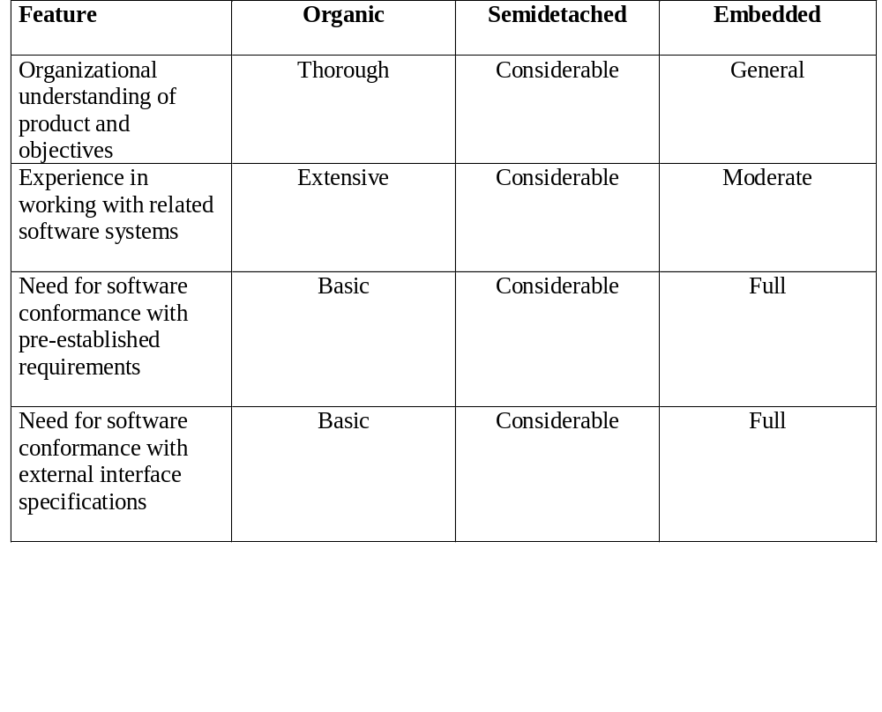
Modes

Slide 50
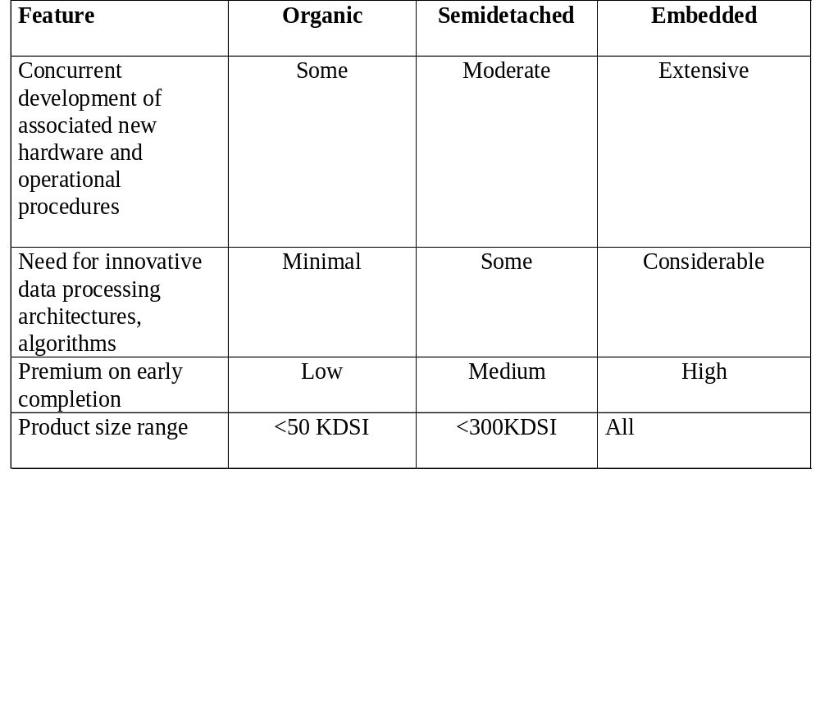
Modes (.)

Slide 51
Cost Estimation Process
Cost=SizeOfTheProject x Productivity
Effort
Size Table
Lines of Code
Number of Use Case
Function Point
Development Time
Estimation Process
Number of Personnel
Errors

Slide 52
Project Size - Metrics
Number of functional requirements
Cumulative number of functional and non-functional requirements
Number of Customer Test Cases
Number of ‘typical sized’ use cases
Number of inquiries
Number of files accessed (external, internal, master)
Total number of components (subsystems, modules, procedures, routines, classes, methods)
Total number of interfaces
Number of System Integration Test Cases
Number of input and output parameters (summed over each interface)
Number of Designer Unit Test Cases
Number of decisions (if, case statements) summed over each routine or method
Lines of Code, summed over each routine or method

Slide 53
Function Points
STEP 1: measure size in terms of the amount of functionality in a system. Function points are computed by first calculating an unadjusted function point count (UFC). Counts are made for the following categories
  •External inputs – those items provided by the user that describe distinct application-oriented data (such as file names and menu selections)
  •External outputs – those items provided to the user that generate distinct application-oriented data (such as reports and messages, rather than the individual components of these)
  •External inquiries – interactive inputs requiring a response
  •External files – machine-readable interfaces to other systems
  •Internal files – logical master files in the system

Slide 54
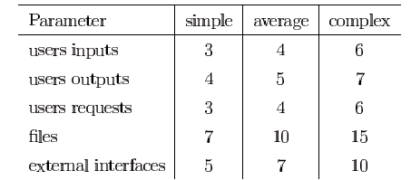
Function Points(..)
STEP 2: Multiply each number by a weight factor, according to complexity (simple, average or complex) of the parameter, associated with that number. The value is given by a table:

Slide 55
Function Points(...)
STEP 3: Calculate the total UFP (Unadjusted Function Points)
STEP 4: Calculate the total TCF (Technical Complexity Factor) by giving a value between 0 and 5 according to the importance of the following points:

Slide 56
Function Points(....)
    Technical Complexity Factors:
      1. Data Communication
      2. Distributed Data Processing
      3. Performance Criteria
      4. Heavily Utilized Hardware
      5. High Transaction Rates
      6. Online Data Entry
      7. Online Updating
      8. End-user Efficiency
      9. Complex Computations
      10. Reusability
      11. Ease of Installation
      12. Ease of Operation
      13. Portability
      14. Maintainability

Slide 57
Function Points(.....)
STEP 5: Sum the resulting numbers too obtain DI (degree of influence)
STEP 6: TCF (Technical Complexity Factor) by given by the formula
  TCF=0.65+0.01*DI
STEP 6: Function Points are by given by the formula
  FP=UFP*TCF

Slide 58
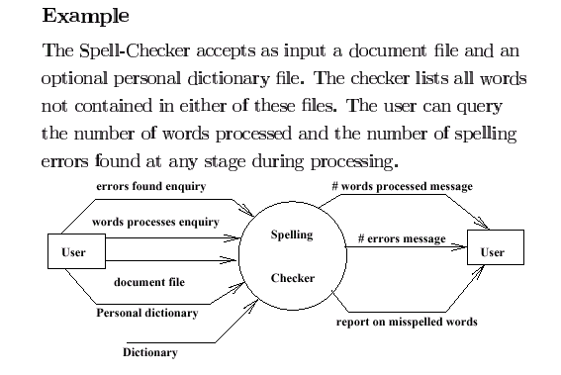
Example

Slide 59
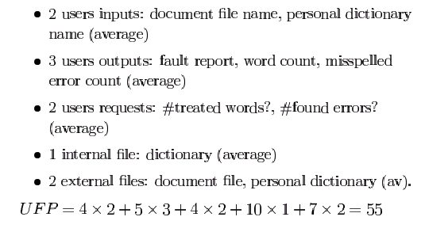
Example (.)

Slide 60
Example (..)
    Technical Complexity Factors:
      1. Data Communication 3
      2. Distributed Data Processing 0
      3. Performance Criteria 4
      4. Heavily Utilized Hardware 0
      5. High Transaction Rates 3
      6. Online Data Entry 3
      7. Online Updating 3
      8. End-user Efficiency 3
      9. Complex Computations 0
      10. Reusability 3
      11. Ease of Installation 3
      12. Ease of Operation 5
      13. Portability 3
      14. Maintainability 3
        DI =30 (Degree of Influence)

Slide 61
Example (…)
Function Points
  FP=UFP*(0.65+0.01*DI)= 55*(0.65+0.01*30)=52.25
  That means the is FP=52.25

Slide 62
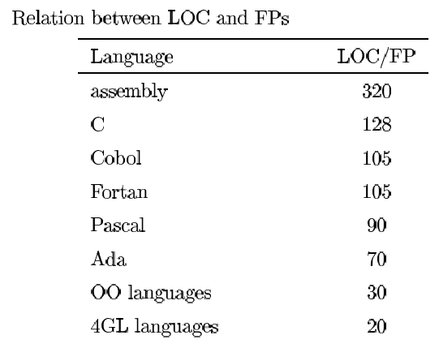
Relation between LOC and FP
Relationship:
  LOC = Language Factor * FP
  where
    LOC (Lines of Code)
    FP (Function Points)

Slide 63
Relation between LOC and FP(.)
Assuming LOC’s per FP for:
Java = 53,
C++ = 64
aKLOC = FP * LOC_per_FP / 1000
It means for the SpellChekcer Example: (Java)
LOC=52.25*53=2769.25 LOC or 2.76 KLOC

Slide 64
Effort Computation
The Basic COCOMO model computes effort as a function of program size. The Basic COCOMO equation is:
  E = aKLOC^b
Effort for three modes of Basic COCOMO.
Mode | a | b
Organic | 2.4 | 1.05
Semi-detached | 3.0 | 1.12
Embedded | 3.6 | 1.20

Slide 65

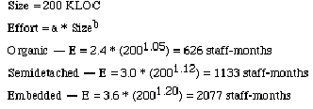
Example

Slide 66
Effort Computation
The intermediate COCOMO model computes effort as a function of program size and a set of cost drivers. The Intermediate COCOMO equation is:
  E = aKLOC^b*EAF
Effort for three modes of intermediate COCOMO.
Mode | a | b
Organic | 3.2 | 1.05
Semi-detached | 3.0 | 1.12
Embedded | 2.8 | 1.20

Slide 67
Effort computation(.)
Effort Adjustment Factor
Cost Driver
Very
Low
Low
Nominal
High
Very
High
Extra
High
Required Reliability
.75
.88
1.00
1.15
1.40
1.40
Database Size
.94
.94
1.00
1.08
1.16
1.16
Product Complexity
.70
.85
1.00
1.15
1.30
1.65
Execution Time Constraint
1.00
1.00
1.00
1.11
1.30
1.66
Main Storage Constraint
1.00
1.00
1.00
1.06
1.21
1.56
Virtual Machine Volatility
.87
.87
1.00
1.15
1.30
1.30
Comp Turn Around Time
.87
.87
1.00
1.07
1.15
1.15
Analyst Capability
1.46
1.19
1.00
.86
.71
.71
Application Experience
1.29
1.13
1.00
.91
.82
.82
Programmers Capability
1.42
1.17
1.00
.86
.70
.70
Virtual machine Experience
1.21
1.10
1.00
.90
.90
.90
Language Experience
1.14
1.07
1.00
.95
.95
.95
Modern Prog Practices
1.24
1.10
1.00
.91
.82
.82
SW Tools
1.24
1.10
1.00
.91
.83
.83
Required Dev Schedule
1.23
1.08
1.00
1.04
1.10

Slide 68
Effort Computation (..)
Total EAF = Product of the selected factors
Adjusted value of Effort: Adjusted Person Months:
APM = (Total EAF) * PM
PM – Person Months

Slide 69


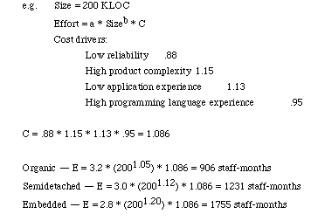
Example

Slide 70
Software Development Time
Development Time Equation Parameter Table:
Development Time, TDEV = C * (APM^D)
Number of Personnel, NP = APM / TDEV
Parameter | Organic | Semi-detached | Embedded
C | 2.5 | 2.5 | 2.5
D | 0.38 | 0.35 | 0.32

Slide 71
Distribution of Effort (.)
The following table gives the recommended percentage distribution of Effort (APM) and TDEV for these stages:
Percentage Distribution of Effort and Time Table:
Req
Analysis
Design,
HLD + DD
Implementation
Testing
Effort
23%
29%
22%
21%
100%
TDEV
39%
25%
15%
21%
100%

Slide 72
Advantages and Disadvantages
Advantage
  COCOMO is transparent, one can see how it works unlike other models.
  Drivers are particularly helpful to the estimator to understand the impact of different factors that affect project costs
Disadvantages
  It is hard to accurately estimate KLOC early on in the project, when most effort estimates are required
  Extremely vulnerable to mis-classification of the development mode
  Success depends largely on tuning the model to the needs of the organization, using historical data which is not always available

Slide 73
Staffing
4 factors in people management.
1. Consistency-
people in project should be treated in a comparable way.
Rewards should be same,
Undervalued…
2. Respect-
diff people diff skills.
Respect it.
All members should be given same chance.
Fit in team..?

Slide 74
3. Inclusion –
feel of listening..
Good working environment for all.
Junior, senior.
4. Honesty-
technical knowledge..
Will respect…

Slide 75
Selecting Staff- how to appoint to a project
1. Information provided by candidates about their background.
Resume..
2. Info from interviews, communicator, social skills.
But interviews are not capable to judge technical capabilities.
3.Recommendations from people who worked with…
Only recommend those you know.

Slide 76
Specific skills…
Company location..
Recent graduates will not have specific skills.

Slide 77
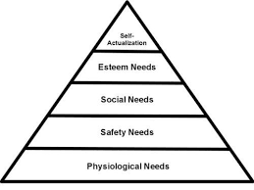
Motivating people- Mashlow

Slide 78
People are motivated by satisfying your needs
Hierarchy..
Lower level- fundamental needs,
Social needs- Social grouping.
Esteem needs- need to feel respect by others.

Slide 79
To satisfy social needs give time to people to meet co workers.
Same place.. Easy
But different place…
Electronic medium does not satisfy social needs
Face to face is necessary..

Slide 80
To satisfy esteem needs you should show people you are valued by the organization.
Public recognition..
Paid at level..@ skills, experience.

Slide 81
Self realisation needs
You need to give people responsibility for their work.
Assign them demanding works & not impossible works.
Tarining..

Slide 82
Classification of professionals- BASS/ DUNTEMAN
1. Task oriented people- are motivated by work they do.
In SE its intellectual challenge.
2. Self oriented people- motivated by personal success, recognition.
3. Interaction oriented people- presence & actions of coworkers.

Slide 83
Managing Groups- factors infulencing.
1. Group Composition- skills, experience, personalities.
2. Group Cohesiveness- collection of individuals opinions.
3.Group Communications-
4. Group Organization- everyone feels organized

Slide 84
Software Configuration Management
Configuration management: the art of coordinating software development to minimize confusion
Configuration management is the art of identifying, organizing, and controlling modifications to the software being built
The goal is to maximize productivity by minimizing mistakes

Slide 85
Introduction
SCM is an umbrella activity that is applied throughout the software process
All information produced as part of the software process are collectively called a software configuration

Slide 86
Introduction
First Law of System Engineering states: No matter where you are in the system life cycle, the system will change, and the desire to change it will persist throughout the life cycle

Slide 87
Introduction
Fundamental sources of change:
  New business or market conditions
  New customer needs
  Reorganization and/or business downsizing
  Budgetary or scheduling

Slide 88
Software Configuration Management Basics
Identification – identifying software configuration items in a baseline
Control – controlling the release of a product and changes to it throughout its lifecycle
Status Accounting – recording and reporting of the status of components and changes
Auditing and Reviewing – Validating the completeness of a product and that SCM procedures are being followed

Slide 89
SCM Definitions
Baseline – One or more software configuration items that have been formally reviewed and agreed upon and serve as a basis for further development
Software Configuration Item – A collection of software elements treated as a unit for the purposes of SCM
Configuration – A collection of all the elements of a baseline and a description of how they fit together

Slide 90
SCM Definitions (cont’d)
Configuration Control Board – Group with the responsibility for reviewing and approving changes to baselines
Software – All of the code, specifications, plans, descriptions, processes, and documents associated with a software development effort
Version – A specific instance of a baseline or configuration item

Slide 91
Concepts
Baseline, IEEE defines a baseline as:
  A specification or product that has been formally reviewed and agreed upon, that thereafter serves as the basis for further development, and that can be changed only through formal change control procedures

Slide 92
Common Baselines
System engineering
Requirement analysis
Software design
Coding
Testing
Release
System specification
Software requirement specification
Design specification
Source code
Test plans/Procedures/Data
Operational system

Slide 93
Software Configuration Item (SCI)
Information created as part of SE process
SCIs used as target in SCM:
  System specification
  Software project plan
  Software requirements specification
  Preliminary user manual
  Design specification
  Source code listing

Slide 94
Software Configuration Item (SCI)
  Test specification
  Operation and installation manuals
  Executable program
  Database description
  As-built user manual
  Maintenance documents
  Standards and procedures for SE

Slide 95
Need for CM
CM needed to deliver product to the client
  What files should comprise the product?
  What versions of these files?
  How to combine these to make the product?
Just for this, versioning is needed, and state of different items has to be tracked
There are other functions of CM also
Other Processes

Slide 96
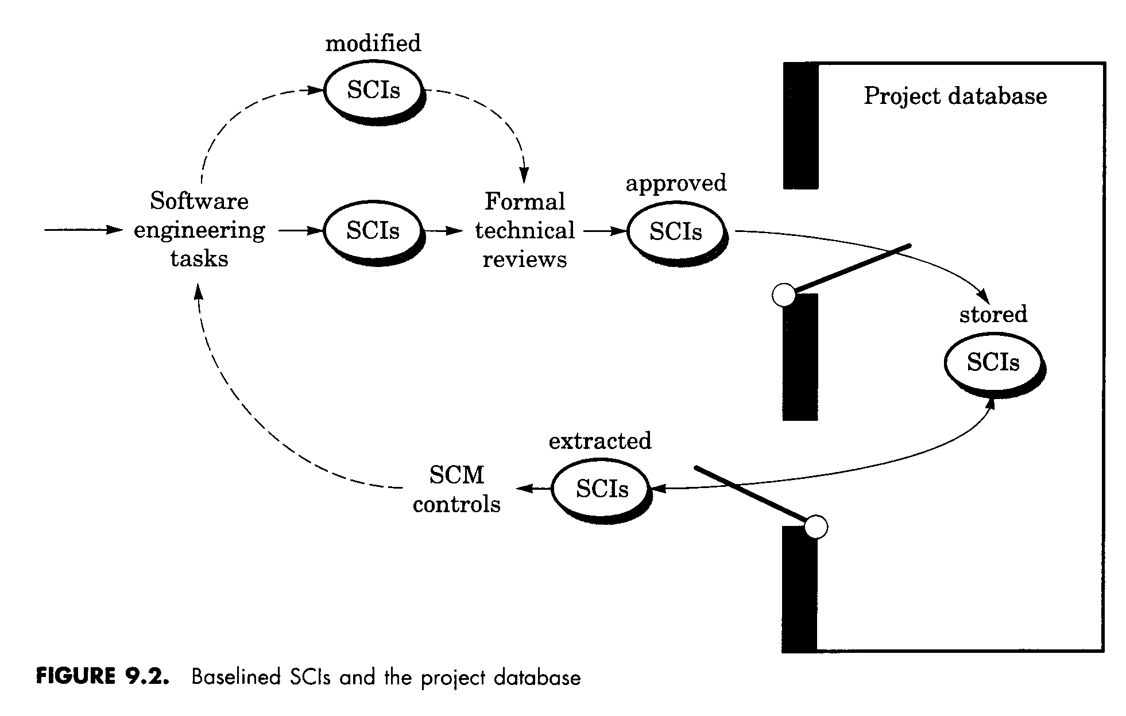
SCI Modification Process
[Pressman, 1997]

Slide 97
Object identification in SW configuration
SCI can be named and organized using OO approach
Two types of objects:
  basic object: ‘unit of text’ created during analysis, design, coding, or testing.
  Aggregated objects: a collect of basic objects

Slide 98
Object identification in SW configuration
Features of objects:
  name: a character string
  description: a list of data items to identify the SCI type and a project id, version information, etc.
  resources: entity that are provided, processed, referenced by the object
  Realization: a pointer to ‘unit of text’ for a basic object or null for an aggregate object

Slide 99
Object identification in SW configuration
Relationships between objects
  part-of: a hierarchical relationship
  interrelated: a cross-structural relationship
Object identification methods
  evolution graph
  automated SCM tools
  module interconnection language

Slide 100
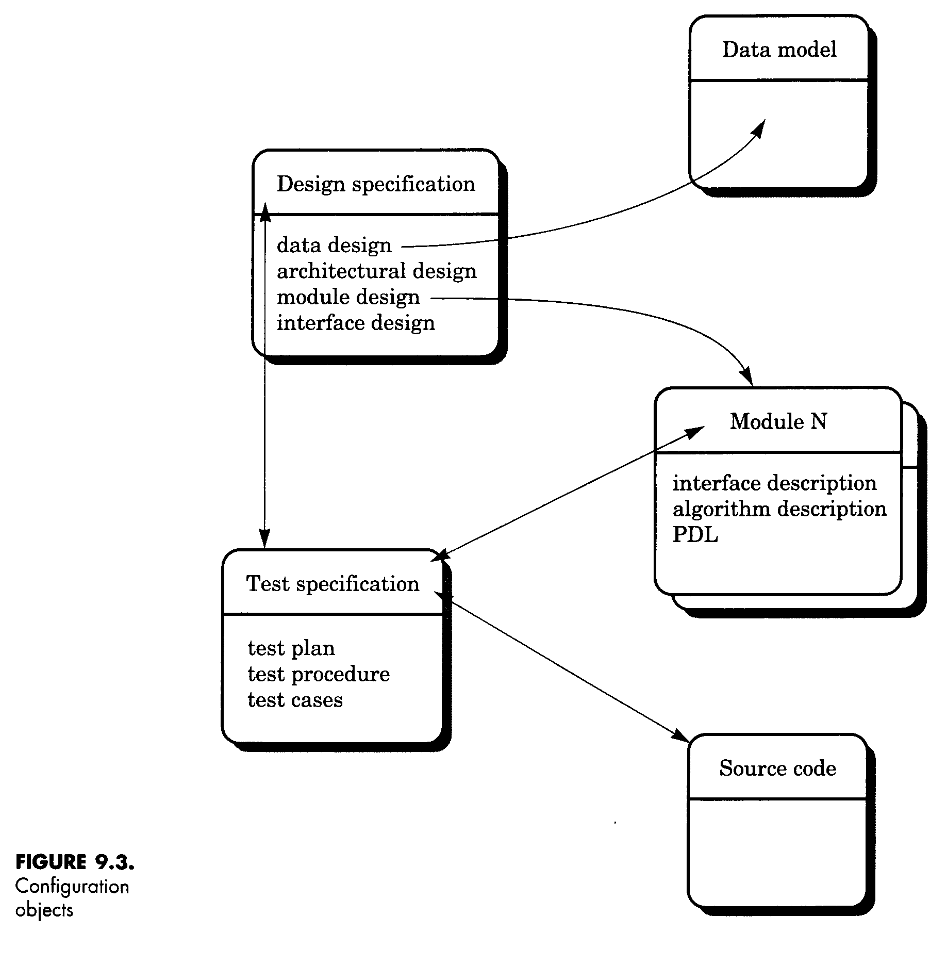
Configuration Objects
[Pressman, 1997]

Slide 101
SCM Process
Identification
Version control
Change control
Configuration auditing
Status reporting

Slide 102
Configuration Control
Enforces a rigorous change control mechanism
Requires formal procedures to
  request changes
  carry out impact analysis
  approve changes
  carry out changes

Slide 103
Evolution Graph
obj
1.3
obj
1.4
obj
1.0
obj
1.1
obj
1.2
obj
2.0
obj
2.1
obj
1.1.1
obj
1.1.2
[Pressman, 1997]

Slide 104
Merging
Two diverging versions may be merged to create a single new version combining both set of change requests.
Merge operations are typically done interactively with tool assistance

Slide 105
Version Control
Some of the issues
  When an executable is built, the versions of its constituents must be consistent.
  If A depends upon B and B is recompiled, A may also need to be recompiled.
  What if multiple people need to modify same SCI?
  Need to know what version different customers have
  How do you keep track of 100’s or 1000’s of modules?

Slide 106
Version Control
Evolution graph to represent different versions
Uses an object pool representing components, variants and versions, and their relationship
RCS (Revision Control System) is common tool.
  Use for documentation as well as code development
[Conradi, 1998]

Slide 107
Techniques for storing Versions
Full files
Forward Delta files
Reverse Delta files
The set of differences between two versions is called a delta.
[Conradi, 1998]

Slide 108
Version Control Support
At the language level (in Ada):
If only body of B changes, no change to A
If spec of B changes, A must be recompiled
With B;
Spec A
Body A
Spec B
Body B

Slide 109
Change Control
    Change request from user
Developer evaluates
Change report is generated
Change control authority makes decision
Request is queued, persons are assigned
“Check out” SCI(s)
Change request is denied
User is informed

Slide 110
Change Control
Make the change/review change
‘Check in’ changed SCIs
Establish a baseline for testing
Do SQA and ‘promote’ changes for inclusion in next release
Rebuild appropriate version
Audit the SCI changes/ include changes in new version
Release the new version

Slide 111
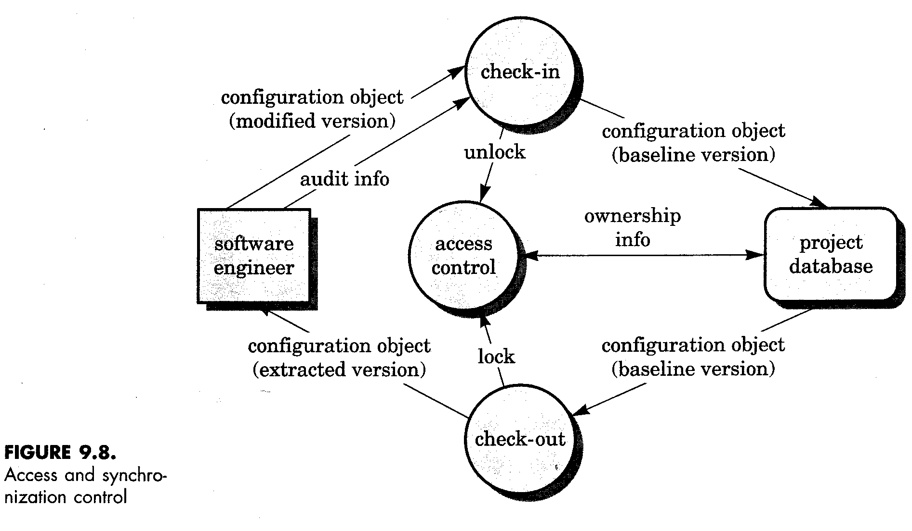
Access and Synchronization Control
[Pressman, 1997]

Slide 112
Configuration Audit
Two approaches can be used to ensure proper implementation of change:
  formal technical review (FTR)
  software configuration audit
CA assesses a configuration object for characteristics that are not generally not considered during review
CA generally checks:
Changes incorporated
FTR conducted
SE standards followed
SCM procedures followed
all related SCIs properly updated
change date and author specified

Slide 113
Status Reporting
Event occurred -- An SCI received updated ID
people involved
Time happened
Effects on others
Generated on a regular basis
To improve communication among all parties

Slide 114
Organising for SCM
Roles:
Configuration manager
Change Control Board
includes representatives of
- user
- customer
- developer

Slide 115
SCM Planning
The SCM Plan is prepared in Project Initiation phase. It documents
- what SCM activities are to be done
- how they are to be done
- who is responsible for doing specific
activities
- when they are to happen
- what resources are required

Slide 116
SCM Planning
The outcome of the SCM planning phase is the Software Configuration Management Plan (SCMP), which might be extended or revised during the rest of the project.
The SCMP can either follow a public standard like the IEEE 828, or an internal (e.g. company specific) standard.

Slide 117
SCM Tools
Common features of popular PC-based tools (PVCS, MS Visual SourceSafe):
Support for controlling all types of files (source code as well as binary)
Managing changes as deltas
Supporting branching and merging
Identifying and re-creating releases
Providing a project view

Slide 118
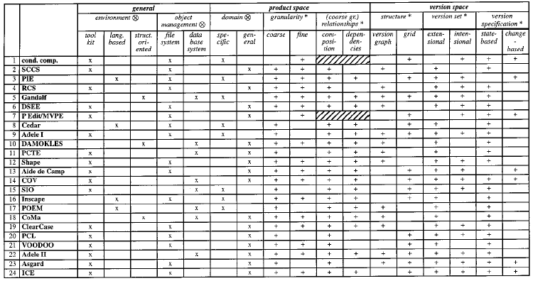
SCM Tools
[Conradi, 1998]

Slide 119
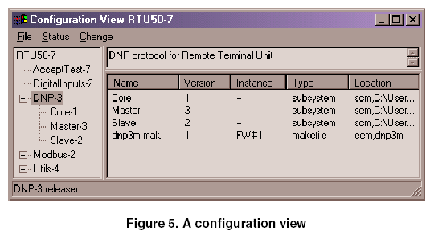
Research Tools
[Volzer, 2002]

Slide 120
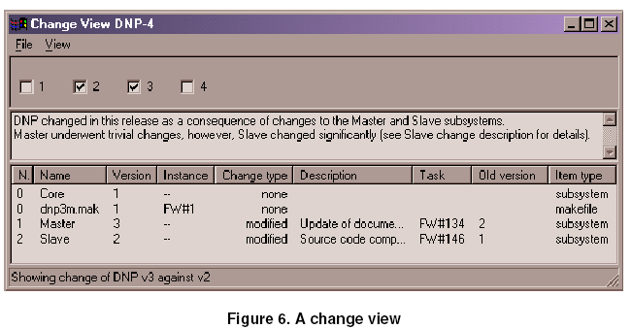
Research Tools
[Volzer, 2002]

Slide 121
Outline of a Software Configuration Management Plan (SCMP, IEEE 828-1990)
1. Introduction
  Describes purpose, scope of application, key terms and references
2. Management (Who?)
  Identifies the responsibilities and authorities for accomplishing the planned configuration management activities
3. Activities (What?)
  Identifies the activities to be performed in applying to the project.

Slide 122
Outline of a Software Configuration Management Plan (SCMP, IEEE 828-1990)
4. Schedule (When?)
  Establishes the sequence and coordination of the SCM activities with project mile stones.
5. Resources (How?)
  Identifies tools and techniques required for the implementation of the SCMP
6. Maintenance
  Identifies activities and responsibilities on how the SCMP will be kept current during the life-cycle of the project.

